Slide 1
CSE413 – Security of Information Systems 2020 PhD Furkan Gözükara, Toros University https://github.com/FurkanGozukara/Security-of-Information-Systems-CSE413-2020
Lecture 9
Identity Management and Access Control
Composed from Prof. Audun Jøsang, University of Oslo, Information Security 2018 Lectures
Source : https://www.uio.no/studier/emner/matnat/ifi/INF3510/v18/lectures/

Slide 2
Outline
Identity and access management concepts
Identity management models
Access control models (security models)
2

Slide 3
IAM
Identity and Access Management
Configuration phase Operation phase
Registration
Self identification
Identity Management
Provisioning
Authentication
Authorization
Access Management
Access Control
3

Slide 4
Definition of IAM
Identity and access management (IAM) is the security discipline that enables the right individuals to access the right resources at the right times for the right reasons.
IAM addresses the mission-critical need to ensure appropriate access to resources across increasingly heterogeneous technology environments, and to meet increasingly rigorous compliance requirements.
Gartner, security glossary
http://blogs.gartner.com/it-glossary/identity-and-access-management-iam/
4

Slide 5







The concept of identity
Entities
have
Identities consist of
Attributes
Systems
Persons
A
Names, Identifiers & Characteristics
B
C
X
Organisations
Y
Z
5

Slide 6
Concepts related to identity
Entity
A person, organisation, agent, system, session, process, etc.
Identity
A set of names / attributes of entity in a specific domain
An entity may have identities in multiple domains
An entity may have multiple identities in one domain
Digital identity
Digital representation of names / attributes in a way that is suitable for processing by computers
Names and attributes of entity
Can be unique or ambiguous within a domain
Transient or permanent, self defined or defined by authority, interpretation by humans and/or computers, etc
6

Slide 7
Identity
Etymology (original meaning of words)
“identity” = “same one as last time”.
“First-time” authentication is not meaningful
because there is no “previous time”
because the identity first must be created/registered
Authentication requires a first time registration of identity in the form of a name within a domain
Registration can be take two forms:
pre-authentication, from previous identity, e.g. passport
creation of new identity, e.g. new-born baby
7

Slide 8
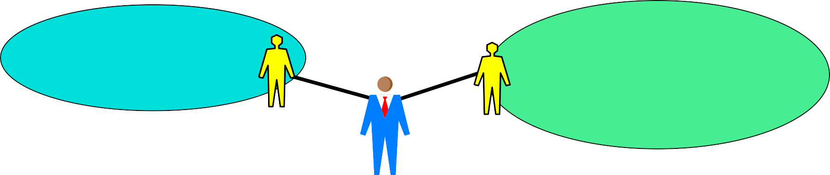
Identity Domains
An identity domain has a name space of unique names
– Same user has separate identities in different domains
Silo Id Domain Service A
Federated Id Domain Service B
Service C
Service D
Id-1
Id-2
User
Identity domain structures:
Silo domain with single authority, e.g. User Ids in company network
Distributed hierarchic domain: e.g. DNS (Domain Name System)
Federated identity domains
Identity domain can be used by many different service providers
Requires alignment of identity policy between domains
8

Slide 9
Taxonomy of Identity Management Architectures
Identity
Management
Silo
Id Mgmt.
Federeated Id Mgmt.
Hybrid Centralised Distributed Federeation
Centralised Federeation
Distributed Federation
9

Slide 10











Silo identity management model
Legend:
SP
IdP
SP/IdP A
SP/IdP B
SP/IdP C
1
1
2
2
3
3
Identity domain
User identifier for silo domain
Authentication token for silo domain
Service logon
Service provision
X
X
10

Slide 11
Silo Id domains
SP (Service Provider) = IdP (Identity Provider): controls name space and provides access credentials
Unique identifier assigned to each entity
Advantages
Simple to deploy, low initial cost for SPs
Potentially good privacy
Disadvantages
SP
Identity overload for users, poor usability, no business integration
Low acceptance of new services with separate Id & credentials
Users must provide same information to many service providers
For service providers: Barrier to service bundling and data collection
11

Slide 12
Identity Federation
Id Federation
– A set of agreements, standards and technologies that enable a group of SPs to recognise and trust user identities and credentials from different IdPs, CrPs and SPs.
Four main types:
Centralized Federation: Centralised name space and
management of credentials by single IdP/CrP.
Distributed Identity with Centralised Authentication: Distributed name spaces managed by multiple IdPs. Centralised credentials authentication by single CrP.
Centralised Identity with Distributed Authentication: Centralised name space managed by single IdP. Distributed mgmt. of credentials and authentication by multiple CrPs.
Distributed Federation: Distributed name spaces and management of credentials by multiple IdPs and CrPs.
12

Slide 13









Identity Federation Types
Federation types | Centralised Identity |  |  | Distributed Identity
Centralised Authentication
 |  |  |  | fa | Distributed Id Centralised Cr cebook twitter
 |  | Centralised Goog | le +
Distributed Authentication | Centralised Id Distributed Cr |  |  | Distributed
13

Slide 14
Federation model types
Aadhaar (India) and google+ are centralised because
they control and manage the domain’s name space of identities,
they always verify the authentication credentials in their federations.
Facebook and Twitter have distributed identities and centralised credentials because
they do not manage identities which are ordinary email addresses,
they always verify the authentication credentials in their federations.
The ID-portal Norway has centralised Id and distributed
authentication because
identities are national id-numbers, managed by the government
multiple private credentials providers verify credentials for authentication
OpenID and eduroam are distributed because
multiple Id-providers control and manage name spaces for identities
the same Id-providers also verify the credentials for authentication

Slide 15







Identity Federation Roles
User
Needs identities and credentials to access multiple SPs.
Service Provider (SP)
Needs to know identity of users, and needs assurance of user authenticity.
Identity Provider (IdP)
Controls name space of identities. Issues/registers identities for users.
Credentials Provider (CrP)
Issues/registers credentials for users. Performs authentication of users.
Id
Often
combined
role
Cr

Slide 16




Federation protocols
Authentication by one IdP/CrP/SP is communicated as a security assertions (cryptographic token) to other SPs that trust and accept the assertion of authenticity.
Usually based on SAML protocol
Security Assertions Markup Language
Involves multiple entities
User, IdP, CrP, SP, and sometimes broker entity
User
Service Provider
(Broker)
Identity/Credentials Provider

Slide 17
Advantage/Disadvantage of Federation
Advantages
Improved usability
Allows SPs to bundle services and collect user info
Strengthen privacy through pseudonym identities
Disadvantages
High technical and legal complexity
High trust requirements between parties
Each federation partner can potentially compromise security
Privacy issues,
Massive data collection is a threat to data privacy
Limited scalability,
Limited by political and economical constraints
An Identity federation can become a new form of silo

Slide 18





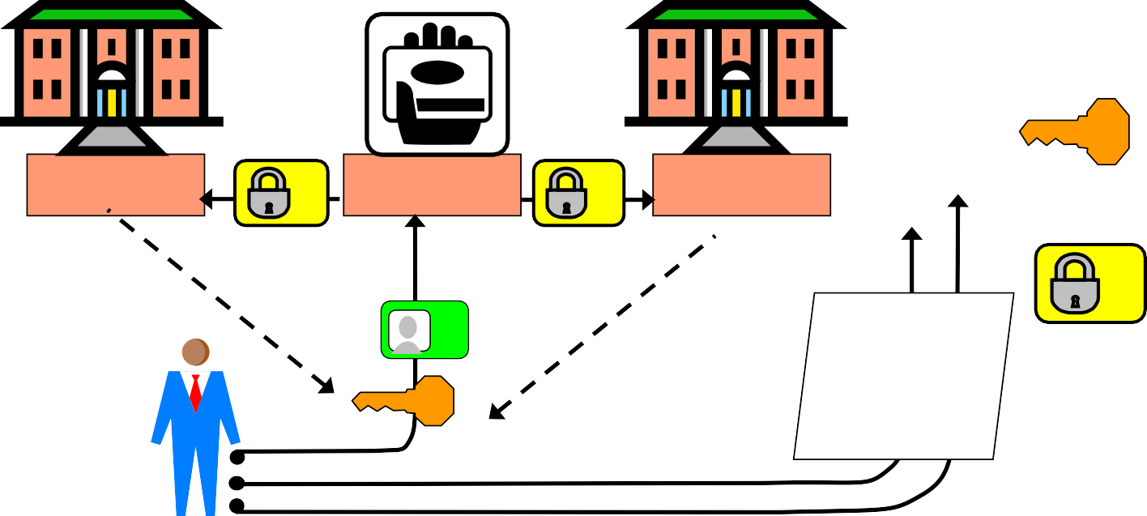
Legend :
Centralised Federation
SP
IdP/CrP
Federation Domain / Circle of Trust
Identity domain
User identifier
issued by IdP
Authentication cred. managed by IdP
Security assertion issued by IdP
Service logon Service provision
Identifier mapping
SP-A
IdP/CrP
SP-B
Authent. to other domains
Examples: Facebook connect

Slide 19
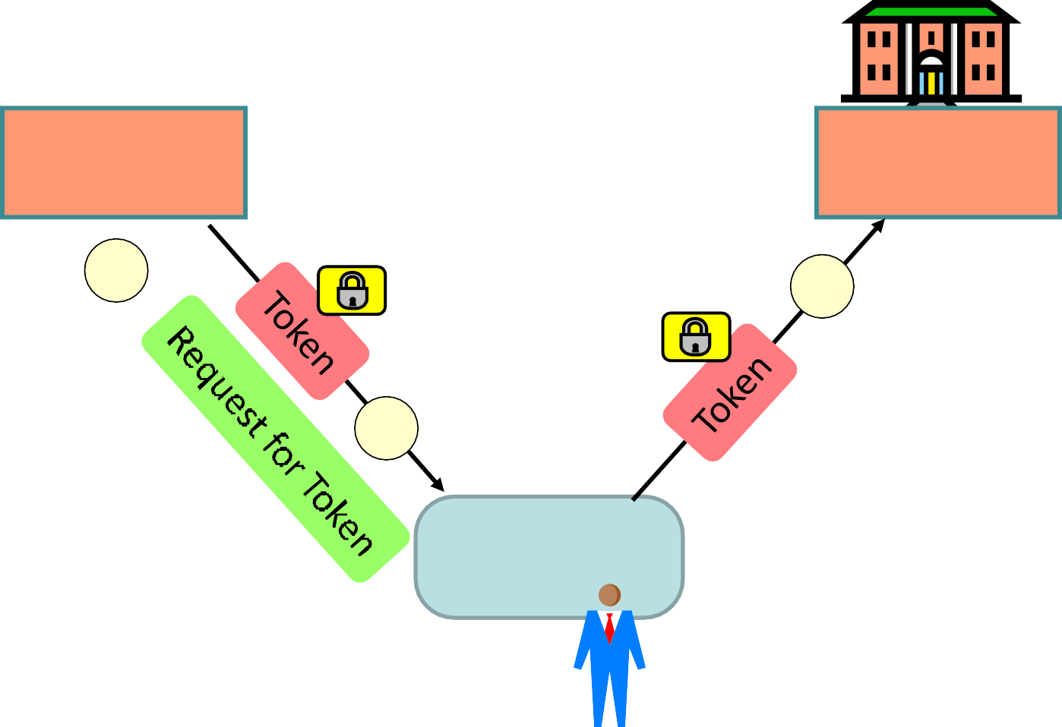


SAML protocol profile: Browser Post Security token via front-channel
Federation circle of trust
Identity Provider
Service Provider
1
3
2
4
Browser
User

Slide 20




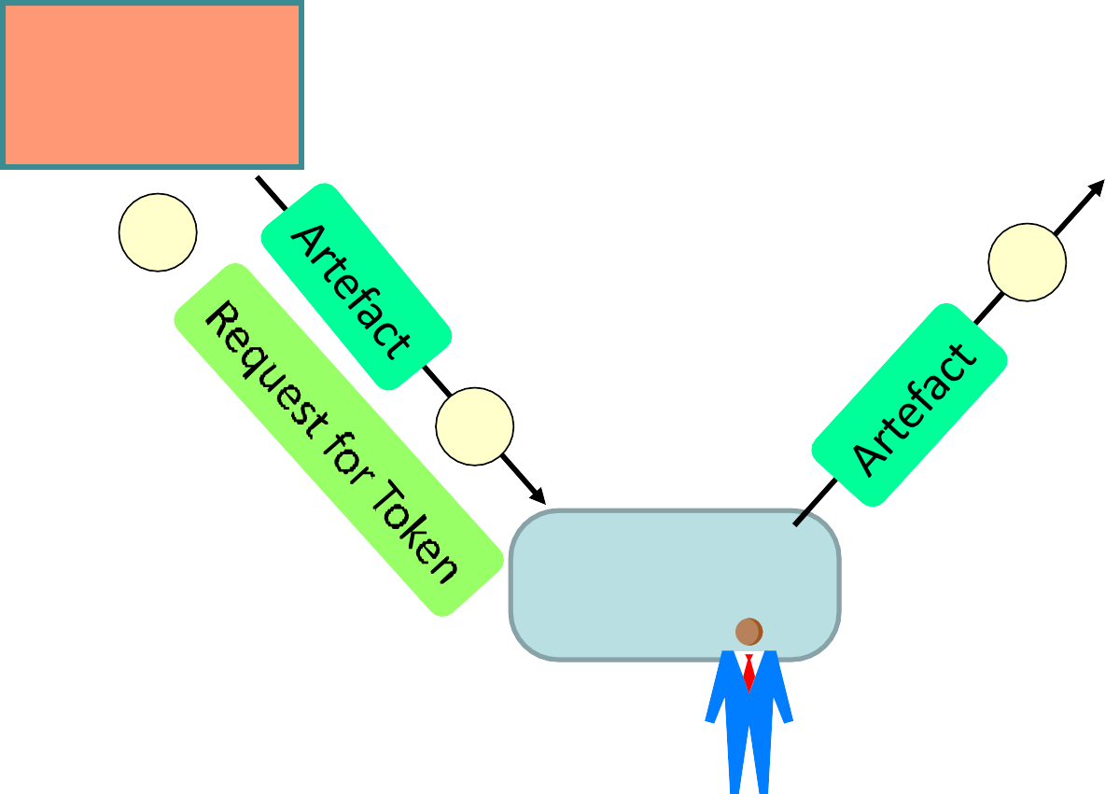
SAML protocol profile: Browser Artefact Security token via back-channel
Federation circle of trust
Identity Provider
Token
5
Service Provider
4
Artefact
The artefact is a
reference to get
1
3
token
2
6
Browser
User

Slide 21




OpenID Connect Protocol
Federation Agreement
Authentication request
Request resource
OpenId IdP
Provide LogIn page
Service
Provider
List of IdPs
6
5
Select IdP
4
2
Post
Creds
8
1
3
Redirect client to get
Token
Token
token from IdP
9
Client
Redirect token to
SP via client
Forward token ¹⁰ back to SP
11
7
Provide Creds
Provide resource

Slide 22
OpenID Connect Characteristics
Based on OpenID and OAuth 2.0 specifications
SPs establish federation agreements with IdPs
Beware of abuse of term “authorization”
The OpenId Connect standard uses “authorization” in the meaning of authentication and access control
OpenID Connect used in the Norwegian HelseID
IAM for the Norwegian health sector
Health professionals register OpenIds that are independent of their national person numbers
Mapping between OpenIds and person number exists
but is protected

Slide 23
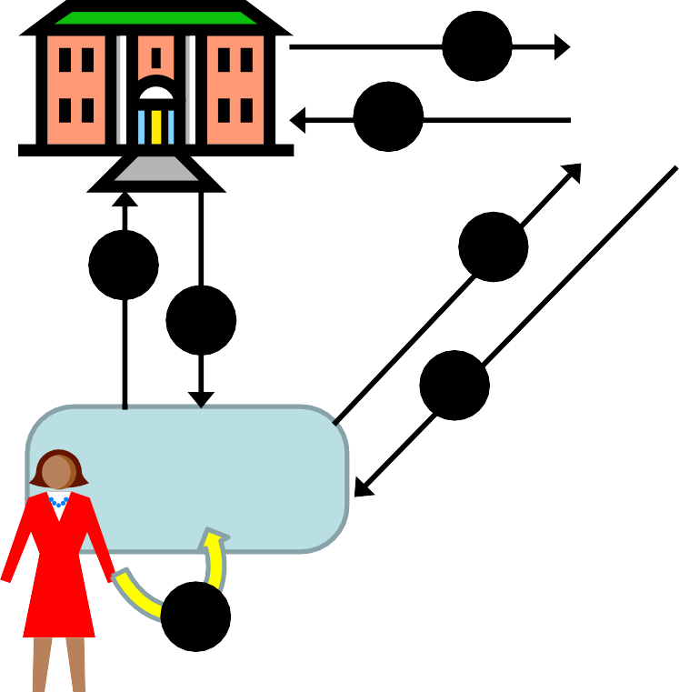


google, facebook and twitter federations
Service
Provider
Authentication with google+, FacebookConnect or twitter
g+ f
t
2
6
1
5
User requests service
Redirect to g+, f or t for authentication
Present login form from g+, f or t
User provides Id and credentials
Credentials forwarded to g+, f or t
Assert authenticated user
Provide service
7
3
Browser
4
User

Slide 24
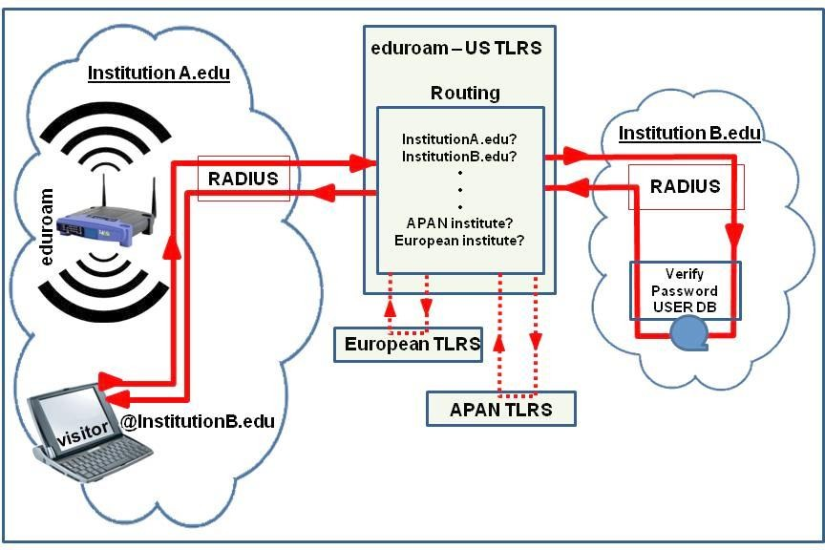
Network access

Slide 25
(continued)
EDUROAM has formal agreements with the public and private locations around Europe for network access
Home Institutions (universities) are responsible for keeping user data and credentials correct and up-to-date
Networks provide Internet access.

Slide 26

(Felles Elektronisk Identitet)
FEIDE is a distributed federation with centralised broker for the Norwegian national education sector.
Users register username and password with own home organisation
Users authenticate to web-services via FEIDE’s centralized login service
The Service Provider receives user attributes from the user’s Home Institution
The Service Providers never sees the user’s password/credential, it only receives user attributes that it need to know in order to provide the service.

Slide 27
(continued)
FEIDE has formal agreements with the universities and schools before they are connected
Home Institutions (universities and schools) are responsible for keeping user data correct and up-to-date
Service Providers decide themselves what services their own users and other users should be able to access via FEIDE’s central log-in service.

Slide 28
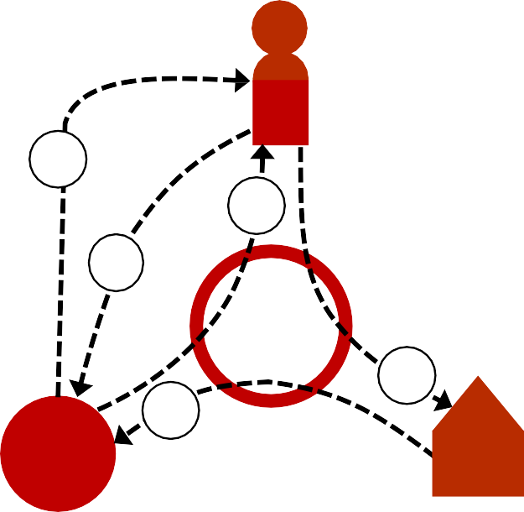
Scenario
User requests access to service
Service Provider sends authentication request to FEIDE, and displays FEIDE login form to user.
User enters name and password in FEIDE login form, which are sent for validation to Home Institution of user.
Home Institution confirms authentic user and provides user attributes to FEIDE which forwards these to SP
Service Provider analyses user attributes and provides service according to policy
User
5
2
1
FEIDE
(broker)
3
4
Service Provider
Home Institution of User (IdP)

Slide 29


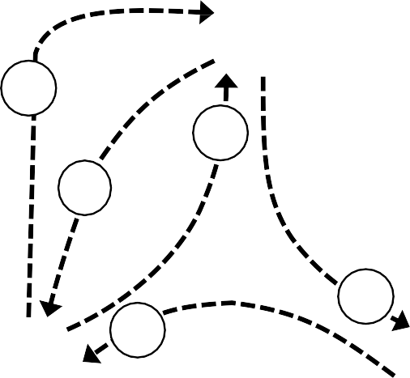


Scenario
User requests service access
Service Provider sends authentication request to Id- portal, and displays ID-portal login form to user.
User selects credentials provider, enters name and password in login form, which are sent for validation to credentials provider of user.
Credentials provider confirms authentic user and provides user attributes to ID-portal which forwards these to SP
Service Provider analyses user attributes and provides service according to policy
User
5
2
1
ID-portal Norway
(broker)
3
Credentials Providers:
BankID (AAL 4)
Confides (AAL 4)
Buypass (AAL 4)
MinID (AAL 3)
4
Government Service Provider

Slide 30
Norw. e-Gov. Distributed Fed. with Broker
Authentication methods
Public services for citizens
Tax
Employment
Education
NAV (Social Sec.)
etc.
MinID (AAL 3)
Confides (AAL 4)
Buypass (AAL 4)
BankID (AAL 4)
ID Porten
DIFI
Public services for
organizations
Tax, VAT (MVA)
Company registration
Financial reports
Subsidies
etc.
SMS PIN (AAL 2)
Altinn PIN (AAL 2) Enterprise Id (AAL 4) Self-Identity (AAL 0)
Altinn Brønnøysund register & IdP

Slide 31






Introduction to Logical Access Control
Physical AC
Secret info
Physical Access Control: (not the theme today)
Logical AC
Secret info
Logical Access Control: (this lecture)

Slide 32
Basic concepts
Access control security models:
How to define which subjects can access which objects
with which access modes?
Three classical approaches
Discretionary Access Control (DAC)
Mandatory access control (MAC)
Role-Based Access Control (RBAC)
Advanced approach for distributed environments:
Attribute-Based Access Control (ABAC)
Generalisation of DAC, MAC and RBAC

Slide 33
Access modes
Modes of access:
Authorizations specify the access permissions of subjects (users) when accessing objects (resources)
If you are authorized to access a resource, what are you allowed to do to the resource?
Example: possible access permissions include
read - observe
write – observe and alter
execute – neither observe nor alter
append - alter

Slide 34
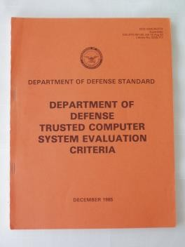



DAC / MAC
According to the Orange Book (TCSEC)
TCSEC (1985) specifies two AC security models
Discretionary AC (DAC)
AC policy based on user identities
e.g. John has (r,w) - access to HR-files
 | HR | Sales
John | r,w
Mary |  | r,w
Mandatory AC (MAC)
AC policy based on security labels
e.g. secret clearance needed for access
Secret
Orange Book, 1985
34

Slide 35
DAC – Discretionary Access Control
Access authorization is specified and enforced based on the identity of the user.
DAC is typically implemented with ACL (Access Control Lists)
DAC is discretionary in the sense that the owner of the resource can decide at his/her discretion who is authorized
Operating systems using DAC:
– Windows and Linux

Slide 36
DAC principles
Columns→ ↓Rows |  | Objects
 |  | O1 | O2 | O3 | O4
Subject names | S1 | r,w | - | x | r
 | S2 | r | - | r | r,w
 | S3 | - | x | - | -
 | S4 | r,w | x | x | x
AC Matrix
General list of authorizations
Impractical, too many empty cells
Access Control Lists (ACL)
Associated with an object
Represent columns from AC Matrix
Tells who can access the object
AC Matrix
 | O1
S1 | r,w
S2 | r
S3 | -
S4 | r,w
 | O2
S1 | -
S2 | -
S3 | x
S4 | x
 | O3
S1 | x
S2 | r
S3 | -
S4 | x
 | O4
S1 | r
S2 | r,w
S3 | -
S4 | x
AC lists →

Slide 37
ACL in Unix
Each file and directory has an associated ACL
Three access operations:
−read: from a file
−write: to a file
−execute: a file
Access applied to a directory:
read: list contents of dir
write: create or rename files in dir
execute: search directory
Permission bits are grouped in three triples that define read, write, and execute access for owner, group, and others.
A ‘-’ indicates that the specific access right is not granted.
rw-r--r-- means: read and write access for the owner, read access for group, and for others (world).
rwx------ means: read, write, and execute access for the owner, no rights for group and no rights for others

Slide 38
Capabilities
Focus on the subjects:
access rights stored with subjects
Represents rows of AC Matrix
Must be impossible for users to create fake capabilities
Subjects may grant own capabilities to other subjects. Subjects may grant the right to grant rights.
Challenges:
How to check who may access a
specific object?
How to revoke a capability?
Similar to SAML security token
AC
Capabilities
↓
 | O1 | O2 | O3 | O4
S1 | r,w | - | x | r
 | O1 | O2 | O3 | O4
S2 | r | - | r | r,w
 | O1 | O2 | O3 | O4
S3 | - | x | - | -
 | O1 | O2 | O3 | O4
S4 | r,w | x | x | x

Slide 39
MAC – Mandatory Access Control
Access authorization is specified and enforced with security labels
Security clearance for subjects
Classification levels for objects
MAC compares subject and object labels
MAC is mandatory in the sense that users do not control access to the resources they create.
A system-wide set of AC policy rules for subjects and objects determine modes of access
OS with MAC:
SE Linux supports MAC

Slide 40
MAC principles: Labels
Security Labels can be assigned to subjects and objects
Can be strictly ordered security levels, e.g. “Confidential” or “Secret”
Can also be partially ordered categories, e.g. {Sales-dep, HR-dep}
Dominance relationship between labels
( L_{A} ≥ L_{B} ) means that label L_{A} dominates label L_{B}
Object labels are assigned according to sensitivity
Subject labels are determined by security clearance
Access control decisions are made by comparing the subject label with the object label according to specific model
MAC is typically based on Bell-LaPadula model (see later)
Subject
Object
compare

Slide 41
Bell-LaPadula: The classical MAC model
SS-property (Simple Security): No Read Up
A subject should not be able to read files with a higher label than its own label, because otherwise it could cause unauthorized disclosure of sensitive information.
So you should only be able to read documents with an equal or lower label as your security clearance level.
*-Property (Star Property): No Write Down
Subjects working on information/tasks at a given level should not be allowed to write to a lower level, because otherwise it could create unauthorized information flow.
So you should only be able write to files with an equal or higher label as your security clearance level.

Slide 42
Bell-LaPadula (MAC model) SS-Property: No Read Up
Top Secret
Current Subject Label
Secret
read
Object Labels
read
Secret
read
Confidential

Slide 43
Bell-LaPadula (MAC model)
*-Property: No Write Down
Diagram
Current Subject
label
Secret
write
Top Secret
write
Secret
write
Object Labels
Confidential

Slide 44
Labels in Bell La Padula
Users have a clearance level LSM (Subject Max level)
Users log on with a current clearance level L^{SC} (Subject
Current level) where L^{SC} ≤ LSM
Objects have a sensitivity level L^{O} (Object)
SS-property allows read access when L^{SC} ≥ L^{O}
*-property allows write access when L^{SC} ≤ L^{O}

Slide 45
Bell-LaPadula label relationships
Object labels L^{O}
A
Subject Max label (clearance) LSM
write access
B
C
Dominance
D
Subject Current label L^{SC} = L^{O}
E
Possible L^{SC} read access
E
F
G
H
I

Slide 46
Combined MAC & DAC
Combining access control approaches:
A combination of mandatory and discretionary access
control approaches is often used
MAC is applied first,
DAC applied second after positive MAC
Access granted only if both MAC and DAC positive
Combined MAC/DAC ensures that
no owner can make sensitive information available to unauthorized users, and
‘need to know’ can be applied to limit access that would
otherwise be granted under mandatory rules

Slide 47
RBAC: Role Based Access Control
A user has access to an object based on the assigned role.
Roles are defined based on job functions.
Permissions are defined based on job authority and responsibilities within a job function.
Operations on an object are invocated based on the permissions.
The object is concerned with the user’s role and not the user.

Slide 48
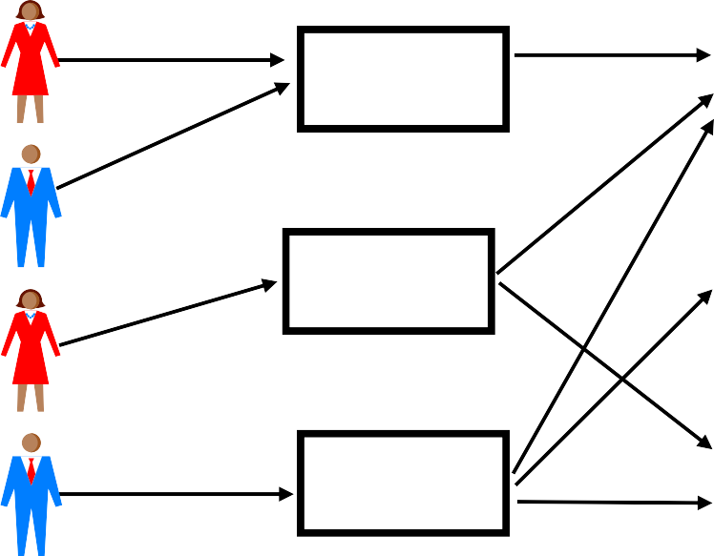
RBAC Flexibility
Users
Roles
Resources
User’s change frequently, roles don’t
Role 1
File 1
Role 2
File 2
Role 3
File 3
RBAC can be configured to do MAC and/or DAC

Slide 49
RBAC Privilege Principles
Roles are engineered based on the principle of least privilege .
A role contains the minimum amount of permissions to instantiate an object.
A user is assigned to a role that allows her to perform only what’s required for that role.
All users with the same role have the same permissions.

Slide 50
ABAC and XACML
ABAC = Attribute Based Access Control
ABAC specifies access authorizations and approves access through policies combined with attributes. The policy rules can apply to any type of attributes (user attributes, resource attribute, context attributed etc.).
XACML used to express ABAC attributes and policies.
XACML = eXtensible Access Control Markup Language
The XACML standard defines a language for expressing access control attributes and policies implemented in XML, and a processing model describing how to evaluate access requests according to the rules defined in policies.
XACML attributes are typically structured in ontologies
50

Slide 51
Attribute Based Access Control
ABAC makes AC decisions based on Boolean conditions on attribute values.
Subject, Object, Context, and Action consist of attributes
Subject attributes could be: Name, Sex, DOB, Role, etc.
Each attributes has a value, e.g.:
(Name (subject) = Alice), (Sex(subject) = F), (Role(subject) = HR-staff),
(AccessType(action) = {read, write}),
(Owner(object) = HR), (Type(object) = salary)
The AC logic analyses all (attribute = value) tuples that are required by the relevant policy.
E.g. permit if:
[ Role(subject) = HR-staff) and (AccessType(action) = read) and (Owner(object) = HR) ] and (Time(query) = office-hours) ]

Slide 52
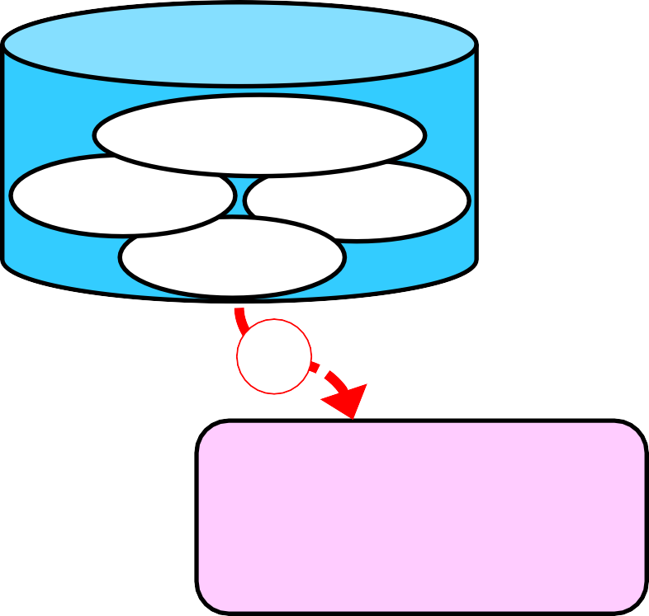




ABAC
Model
AC Policies
Meta Policy
Context
Conditions
Policy 1
Policy 3
Policy 2
2d
2a
Access Action
Request
Access
ABAC Functions
AC decision logic
AC enforcement
2b 2c
3
Object
1
Subject
Subject Attributes Object Attributes
Name Type
Affiliation Owner
Clearance
Classification
etc.
etc.
52

Slide 53
Global Consistence
ABAC systems require an XML terminology to express all possible attributes and their values,
Must be consistent across the entire domain,
e.g. the attribute Role and all its possible values, e.g. (Role(subject) = HR-staff), must be known and interpreted by all systems in the AC security domain.
Requires standardization:
e.g. for access to medical journals, medical terms
must be interpreted in a consistent way by all systems
current international work on XML of medical terms
Consistent interpretation of attributes and values is a major challenge for implementing ABAC.
53

Slide 54
ABAC: + and −
On the positive side:
ABAC is much more flexible than DAC, MAC or RBAC
DAC, MAC and RBAC can be implemented with ABAC
Can use any type of access policies combined with an
unlimited number of attributes
Suitable for access control in distributed environments
e.g. national e-health networks
On the negative side:
Requires defining business concepts in terms of XML and ontologies which is much more complex than what is required in traditional DAC, MAC or RBAC systems.
Political alignment and legal agreements required for ABAC in distributed environments
54

Slide 55
Meta-policies i.c.o. inconsistent policies
Sub-domain authorities defined their own policies
Potential for conflicting policies
E.g. two policies dictate different access decisions
Meta-policy rules needed in case the ABAC logic detects policy rules that lead to opposite decisions
Meta-policy takes priority over all other policies, e.g.
Meta-Policy Deny Overrides: If one policy denies access, but another policy approves access, then access is denied.
This is a conservative meta-policy.
Meta-Policy Approve Overrides: If one policy denies access, but
another policy approves access, then access is approved.
This is a lenient meta-policy.
55

Slide 56
End of lecture

